Slide 1
Strategy chosen for the problem statement
A deep learning model will be trained to detect presence of Humans in the dataset.
Along with it pretrained OCR (optical character recognition) model will be used to detect text in the images. This OCR will look for ”Zomato”, “swiggy” etc in the text
https://github.com/JaidedAI/EasyOCR - OCR mode
The application will be developed using python and flask, and will be deployed on GCP (google cloud)
Grab a frame from webcam
DL model to detect humans
OCR model to detect the delivery partner
Result shown on webpage

Slide 2
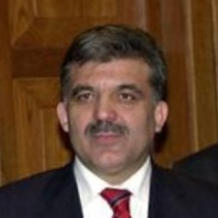

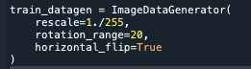
Data preparation for Human – non human classification:
Human vs Non-Human data was gathered frame Kaggle: https://www.kaggle.com/datasets/aliasgartaksali/human-and-non-human
Sample non-human image
(not just cars, wide variety
of images were included)
Sample human image
A total of 8000 images (4000 human, 4000 non human) images are used.
Data augmentation was done with the following parameters
The images were of different sizes. All of them are resized to 720*720. because the webcam is 720*1080 pixels.

Slide 3
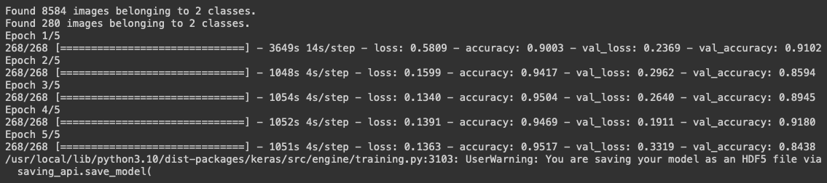
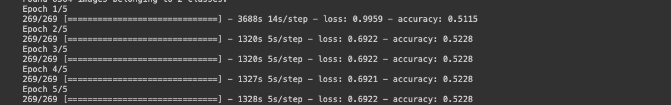
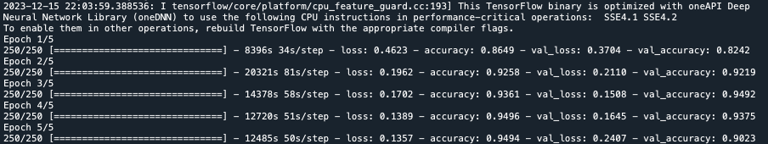
Deep learning modelling
The following models are trained/finetuned:
Method 1: A custom model with 3 convolutional layers and 1 Fully connected layer
2 models with a dropout of 0.5 and 0.1 are trained.
Method 2: Finetuning a pretrained VGG model with 16 layers
2 models by finetuning last 5 layers and last 10 layers were finetuned
Loss function used: Binary cross entropy
Epochs: 5
Because of limitations of google-colab and personal system, training all the above variations in time couldn’t be achieved.
Training for 3 of the models could successfully be complete in time (shown below). The custom model with dropout = 0.5 was finally chosen for next steps
Training progress: Custom model with dropout = 0.1
Training progress: VGG finetuning – last 5 layers
Training progress: Custom model with dropout = 0.5

Slide 4
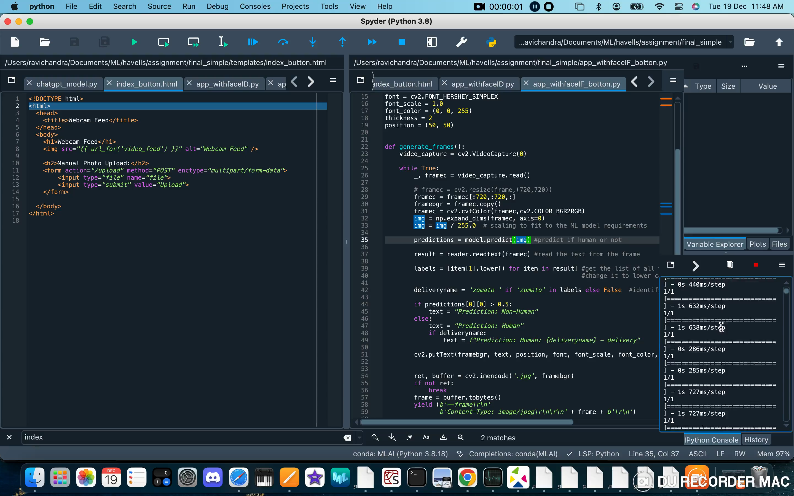
Deployment:
Google cloud (GCP) was used for deployment: https://havells-assignment.el.r.appspot.com
However because of few issues, the webcam is not being recognized from the cloud. As a result, am presenting the result on a local host using flask. Play the below video for the final output.

